Slide 1
Biodiversity in National Parks
Data Analysis Report on the Endangered Species in Four National Parks

Slide 2
Introduction
The goal of this project is to analyze data from the National Parks Service about endangered species in different parks. To accomplish this, data will be prepared, analyzed and plotted in order to better understand the conservation status of the species.
Note: The data used in this project is made to resemble real data, but it is fictitious. Both datasets were provided by Codecademy as part of the course material.

Slide 3
Scope of the project
The National Parks Service wants to ensure the survival of at-risk species in order to maintain biodiversity in their parks.
Therefore, the main objectives of the analysis will be to understand the characteristics of the species and their conservation status, as well as their relationship to the national parks.

Slide 4
Questions we set out to answer
1. What is the distribution of conservation status for the parks?
2. Are certain types of species more likely to be endangered?
3. Are the differences between species and their conservation status significant?
4. Which birds are the most prevalent and what is their distribution amongst parks?

Slide 5
Data

Slide 6
Two Datasets
Species_info.csv
Contains data about different species and their conservation status.
category: class of animal
scientific_name: the scientific name of each species
common_name: the common names of each species
conservation_status: each species’ current conservation status
Rows: 5,824
Observations.csv
Holds recorded sightings of different species at several national parks for the past 7 days.
scientific_name: the scientific name of each species
park_name: park where species were found
observations: the number of times each species was observed at park
Rows: 23,296

Slide 7
Species Dataset
Contains information about 5,824 distinct species in 7 unique categories that include both animals and plants.
The most populous one is the Vascular Plant category, with 4,470 species, and the least represented is the Reptile category, with only 79 species.
Vascular Plant 4470
Bird 521
Nonvascular Plant 333
Mammal 214
Fish 127
Amphibian 80
Reptile 79

Slide 8
Observations Dataset
It contains a total of 3,314,739 observations of 5,541 unique species across 4 unique parks.
The most observed species was Stretopelia decaocto with a count of 1,782 observations during the 7 days.
The most observations were made in the Great Smoky Mountains National Park.

Slide 9
Analysis

Slide 10
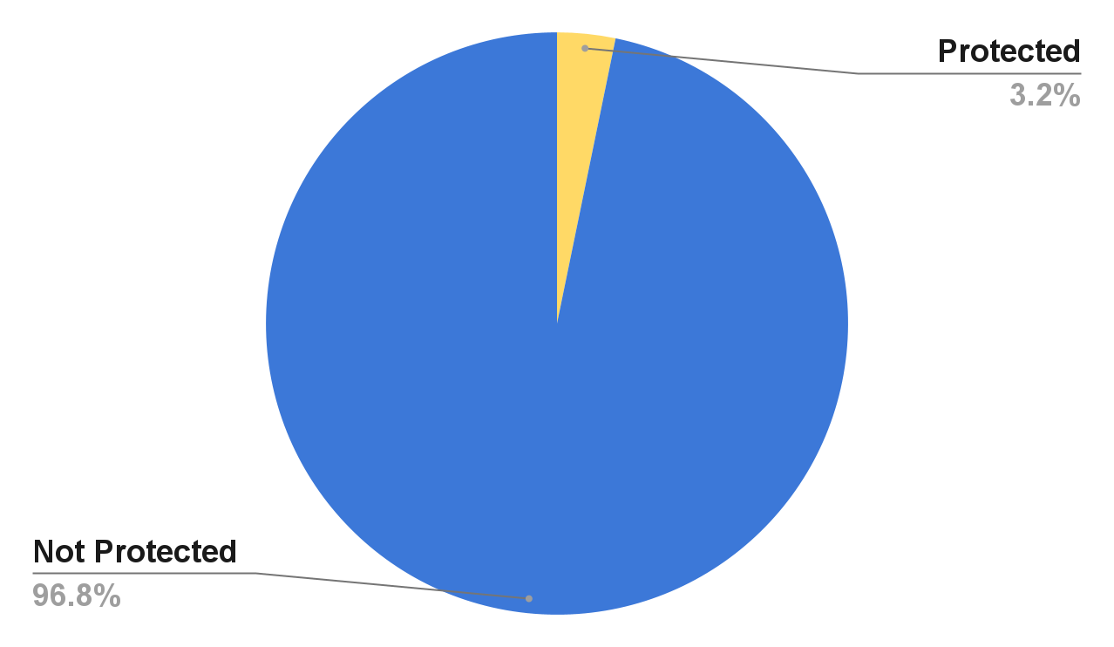
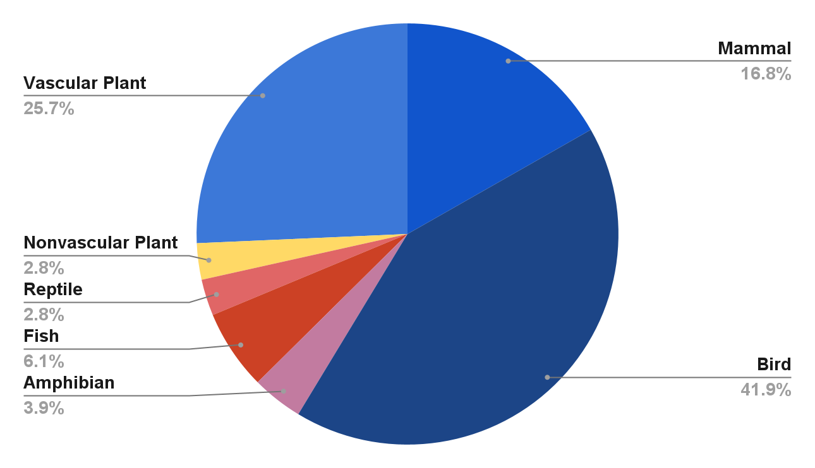
Protected status

Slide 11
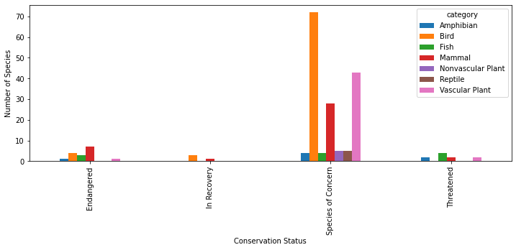
Category breakdown of Conservation Status

Slide 12
Statistical difference in conservation status between categories
Pearson’s chi-squared test to determine if the difference is significant.
Significance threshold: 0.05.
 | Not Protected | Protected
Bird | 413 | 75
Mammal | 146 | 30
 | Not Protected | Protected
Bird | 413 | 75
NonVascular Plants | 328 | 5
P-value: 0.6875948096661336
P-value: 1.0546306904975004e-10

Slide 13
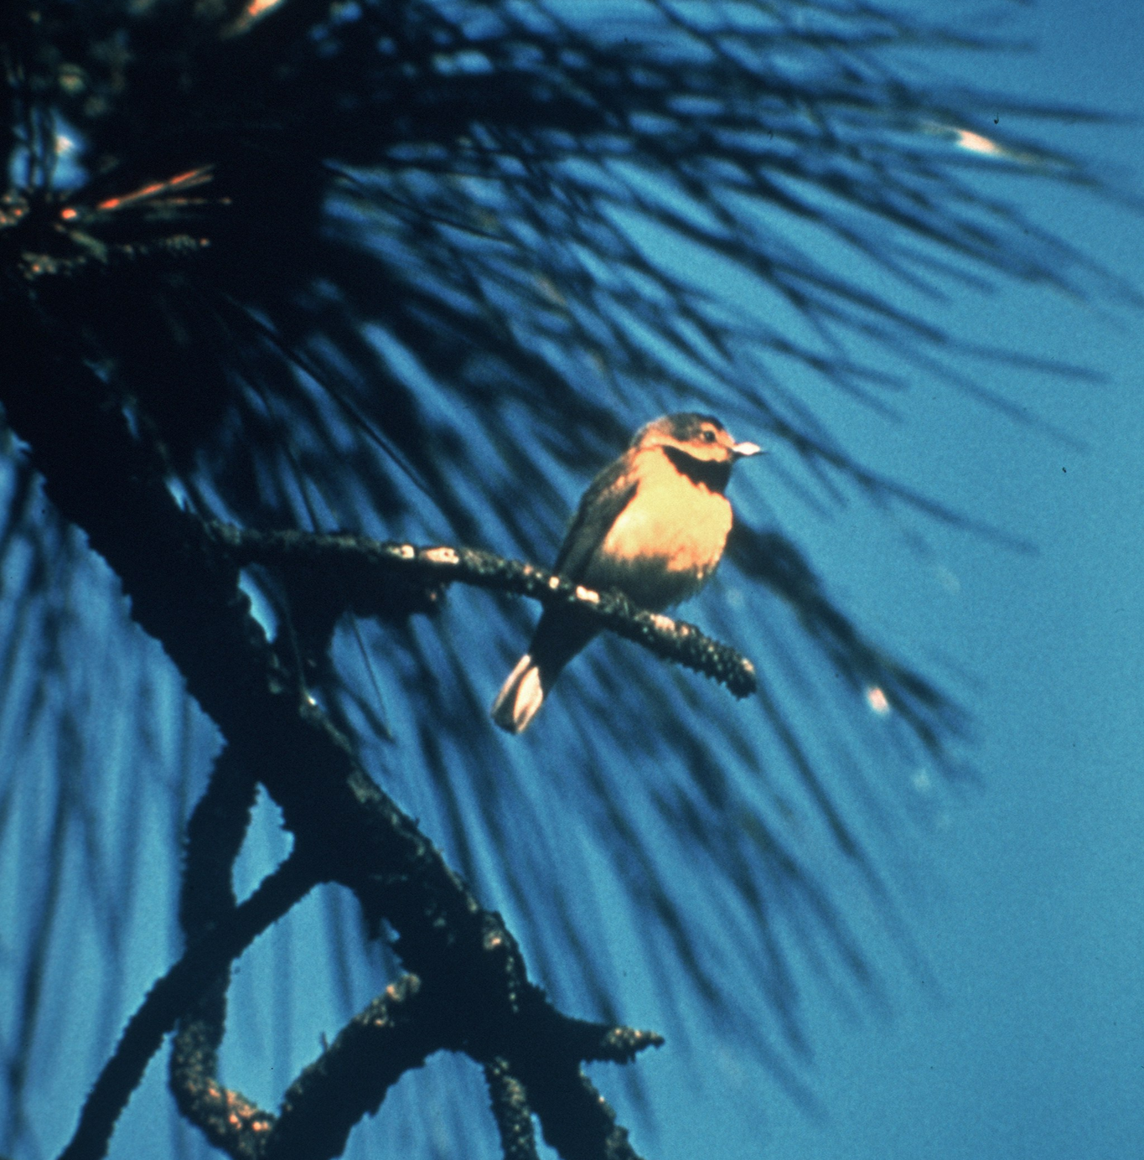
Most prevalent bird species
We have found that the most prevalent bird species in our dataset are Warblers, with 59 mentions, followed by Sparrows, with 29 mentions.
Various Passeriformes are commonly referred to as warblers. They are not necessarily closely related to one another, but share some characteristics, such as being fairly small, vocal, and insectivorous.
Bachman's warbler (Vermivora bachmanii)
Live bird photographed by Jerry A. Payne in 1958

Slide 14
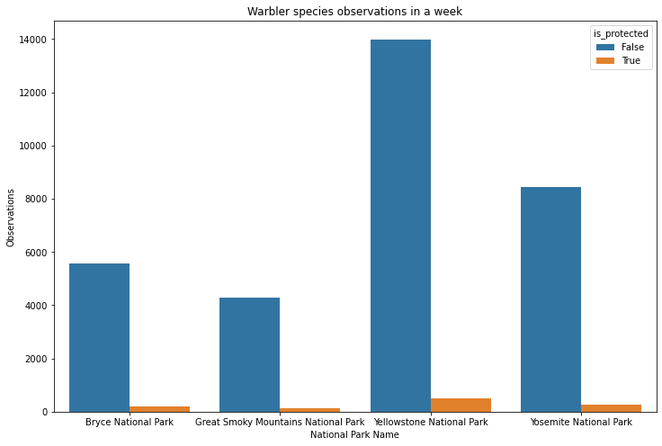
33,394 sightings in 7 days
Most observations were made in the Yellowstone National Park with a total of 14,487 sightings, 492 of which were of protected Warbler species.

Slide 15
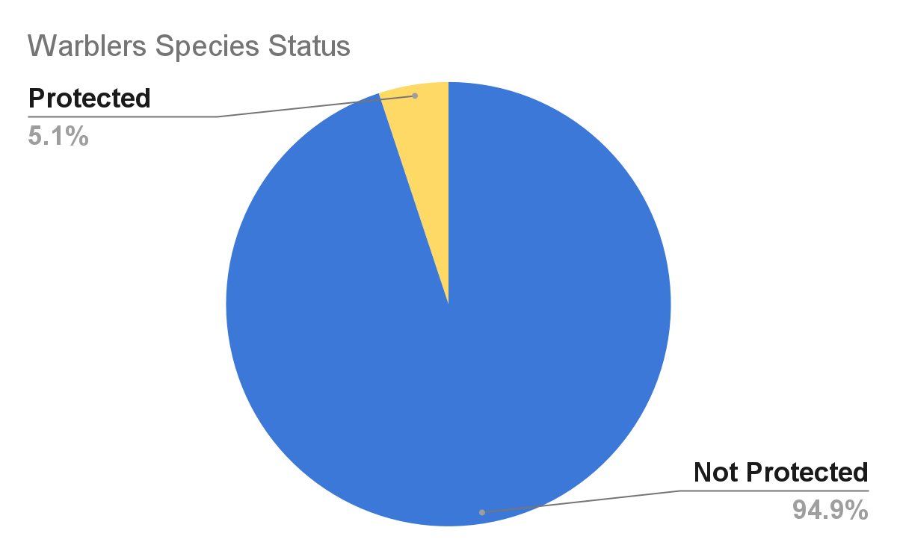
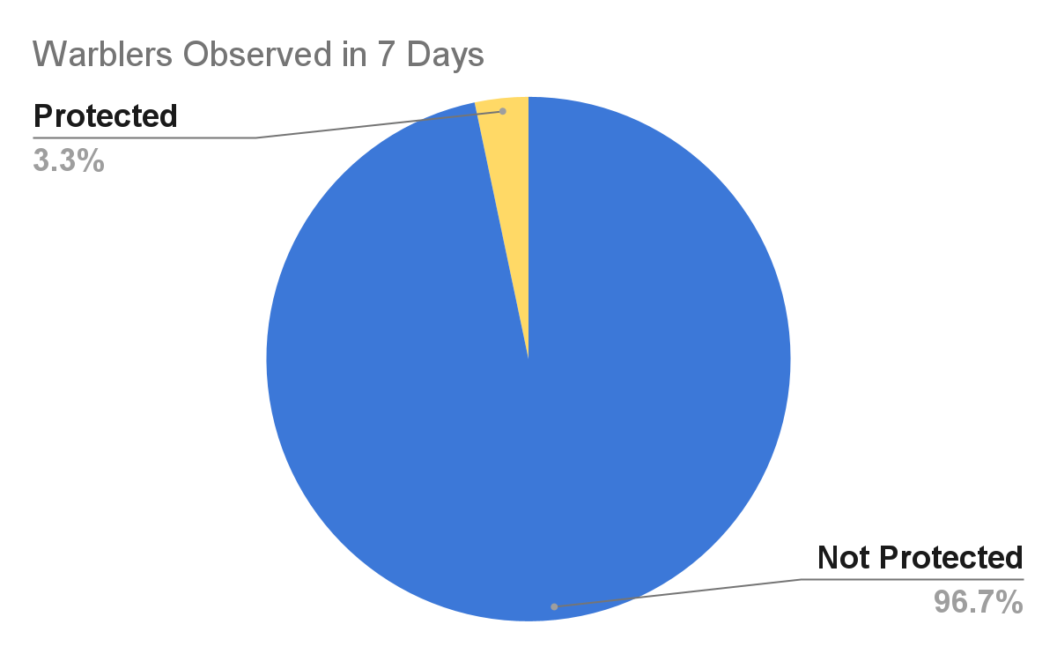
Species vs Observations

Slide 16
Results

Slide 17
What is the distribution of conservation status for species?
The vast majority of species were not part of conservation.(5,363 vs 179)
Are the differences between species and their conservation status significant?
While mammals and birds did not have significant difference in conservation percentage, mammals and nonvascular plants exhibited a statistically significant difference.
Are certain types of species more likely to be endangered?
Mammals and Birds had the highest percentage of being in protection.
Which birds are the most prevalent and what is their distribution amongst parks?
The study found that Warblers occurred the most number of times and they were most likely to be found in Yellowstone National Park.

